Slide 1
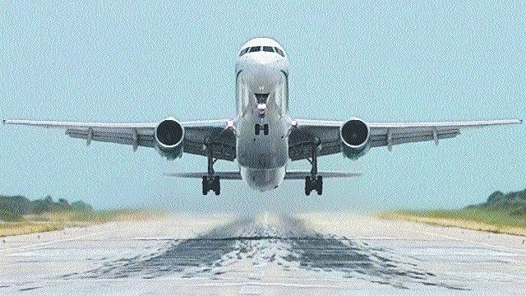
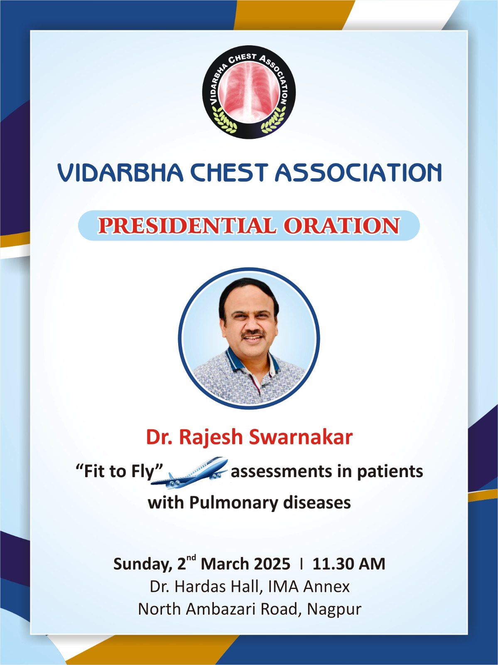
“FIT TO FLY”
Assessments in Patients with
PULMONARY DISEASES

Slide 2
In flight medical emergencies, fourth leading cause is Respiratory.
Close to 4.5 billion people travelled by air in the year 2024 year the world
In financial year 2024, the total air passenger traffic in India reached more than 220 million passengers. It’s a huge increase compared to the previous year.
Given the rising age of populations, the age of air travellers has also increased, with greater propensity for medical impairment.
Respiratory events are estimated to account for 12 percent of In Flight Medical Emergencies (IFME).

Slide 3
Airlines are increasingly scrutinizing sick patents on board especially patents with Oxygen requirement
Depending on the occurrence of medical emergency, diversion,emergency landing of aeroplane can cost anywhere between 30,000 and 7,25,000 USD.
With more people traveling by air, the actual number of inflight medical events has been gradually increasing over the years.

Slide 4
Flight is a Stress
Preflight stresses
carrying baggage
walking long distances
being delayed
Inflight stresses
Lowered barometric pressure and PiO2
Noise, vibration (including turbulence)
Uncomfortable temperatures and low humidity (10‐
20%)
Jet lag, and cramped seating

Slide 5
Flight Environment
Commercial aircraft typically operate at cruising altitudes of 30,000 to 40,000 feet
As altitude increases, ambient air pressure decreases, leading to a decrease in the oxygen tension
Pressurization of cabins on commercial airliners to simulate 8000-10000 feet limits the decrease in air pressure, allowing the airplane or jet to cruise at altitudes up to 40,000 feet without inducing extreme hypobaric stress in the passengers
But Flying at a high altitude can induce significant hypoxemia in patients with underlying lung disease, despite pressurization of airliner cabins.
Lee AP et al, Paed Emerg Care 2002 18:78‐80

Slide 6
Flight Environment :The effects
The decrease in PiO2 and the consequent decrease in PaO2 lead to the increase in minute ventilation as a reflex.
• Healthy subjects have a wide ventilatory reserve; therefore, the increased minute ventilation is generally well tolerated.
• Respiratory patients may not tolerate exposure to
even slightly hypoxic mixtures.
• The hypoxia‐induced pulmonary vasoconstriction
may further worsen the increase of the dead space
and the pulmonary hypertension, which may further
deteriorate the PaO2

Slide 7
Flight Environment :The effects
Hypobaric hypoxemia – precipitates Respiratory Failure
• Expansion of gas in closed cavity,can expand by 30% at 8000 ft (2450 m)
• Pneumothorex
• Pneumomediastinum
• Air embolism
• Risks of DVT, PTE
• Spread of Infectious diseases

Slide 8
Absolute contraindications to air travel
Pneumothorax
Bronchogenic cyst
Severe PAH
Pandemic like situations – Covid –spread of infection rapid.

Slide 9
Respiratory disorders presenting a possible risk for potential air travelers
Asthma
COPD
Pneumothorax
Bronchogenic Cyst
Restrictive Pulmonary Diseases
Cystic Fibrosis
Obstructive Sleep Apnoea Syndrome
Pulmonary Hypertension
Patients on LTOT
Ventilator dependant patients
DVT & PTE
Pulmonary Infections

Slide 10
ASTHMA
Asthma is the most frequent respiratory disease reported by air travelers
(Aerospace Medical Association, Air Transport Medicine
Committee : Medical guidelines for air travel, ed 2. Aviat Space
Environ Med 2003;74:A1–A19.)
Around one third of in‐flight respiratory emergencies are ascribed to asthma
(Cottrel JJ. JAMA 1989; 262: 1653‐6 )
Stable and well‐controlled asthma:– no contraindications to air travel
Unstable asthma/recent exacerbation: avoid air travel.

Slide 11
ASTHMA
Pre flight assessment is recommended
• Patients are advised to carry in hand baggage on board
– Vital medicine including inhalers (reliever and
preventer)
– Course of oral steroids
• From April 2004, bronchodilator inhalers are
included as part of the mandatory medical kit carried by aircraft on flights to and from the USA
• Portable battery‐operated nebulizers may be used at the discretion of cabin crew
• Spacers are as effective as nebulizers

Slide 12
C O P D
COPD pts are particularly susceptible to develop respiratory failure during flights.(Christensen CC et al,Eur Respir J 2000; 15:635–639,Johnson AO et al, Thorax 2003; 58: 729–732.,Seccombe LM et al, Thorax 2004; 59: 966–970.)
• In COPD patients, the ability to increase MV
in response to the hypoxia is limited
• Even modest physical activity during the
flight at high altitude can worsen their gas exchange
High‐risk COPD patients are those
– Dyspnoea on exertion
– Present hypercapnia
– PaO2 values < 70 mm hg or SaO2 < 92%
at sea level
– Maximal voluntary ventilation ventilation < 40 l/min.(Mohr LC et al, Am J Med Sci 2008; 335: 71–79.)

Slide 13
C O P D
Pre flight assessment is recommended
• Medicines and inhalers, as prescribed, should
always be carried in the hand luggage on board
• Portable battery‐operated nebulisers may be
used/ spacer with MDI
• Patients prescribed in‐flight oxygen should
receive oxygen while visiting high altitude
destinations

Slide 14
Pneumothorax
Spontaneous pneumothorax or pneumomediastinum must be excluded before air travel.
• The air volume of a closed cavity can increase
approximately 30% when moving from sea level
to 8,000 ft asl
• The presence of a pneumothorax is an absolute
contraindication to air travel
• The pneumothorax may critically increase during the trip.
BTS recommendations. Thorax 2002; 57: 289–304.Aerospace Medical Association: Aviat Space Environ Med 2003; 74:A1–A19, Fuchs HS et al, Aerosp Med 1967; 38: 1283–1285.

Slide 15
Pneumothorax
Patients who have had a pneumothorax
– CXR must before flight. Wait for seven days to elapse before flight.
• There is insufficient evidence to support six week delay
after resolution, before travel.
• Traumatic pneumothorax ‐2 wks after radiographic
resolution
• Spontaneous Pneumothorax treated by surgical means ‐
allowed to fly once they have recovered from the effects
of their surgery
• Secondary Spontaneous Pneumothorax:‐The risk of
recurrence is higher, may consider alternative forms of
transport for one year of the initial event
BTS recommendations 2022

Slide 16
Bronchogenic Cyst
They are often asymptomatic, however emergencies may be caused by a sudden increase in the size and rupture of the cyst following a rapid decompression
•A few cases of cerebral air embolism have been reported in airplane passengers after bronchogenic cyst rupture
• Most of the cases were fatal
• Patients are advised against activities leading to rapid changes in ambient pressure, such as flying, diving or high altitude climbing or consider elective surgical treatment.
Zaugg M ET AL, Am J Respir Crit Care Med 1998; 157: 1686–1689.
Almeida FA ET AL, Chest 2006; 130: 575–577.
Belcher E et al, Eur Respir J 2007; 30: 801–804
Edwardson Edwardson M et al, Neurocrit Neurocrit Care 2009; 10: 218
–221

Slide 17
Restrictive Pulmonary Diseases
Patients with restrictive defect like ILD or
kyphoscoliosis, can develop a significant hypoxemia
when exposed to hypoxic mixtures , simulating an air
flight
• The decreases in PaO2 and SaO2 worsened when patients performed modest physical activity during the test.
Seccombe LM et al, Thorax 2004; 59: 966–970
Christensen CC et al, Eur Respir J 2002; 20: 300–305.
Chetta A et al, Aviat Space Environ Med 2007; 78: 789–792

Slide 18
Restrictive Pulmonary Diseases
Patients with a restrictive defect, the ability to
increase the minute ventilation in response to
hypoxia is limited
Mohr LC et al, Am J Med Sci 2008; 335: 71–79.
• PaO2 increased to acceptable levels with an O2
supply of 2 L/min at rest and 4 L/min during exercise
is given.
Christensen CC. Eur Respir J 2002;20:300‐305
• Patients with severe restriction especially those with hypoxia should undergo pre flight evaluation or
consider alternative forms of transport
BTS recommendations 2004

Slide 19
Obstructive Sleep Apnoea Syndrome
Periodic breathing and central apnoeas may occur in normal subjects during sleep at high altitude
Weil JV : Principles and Practice of Sleep Medicine, ed 2.London, Saunders, 1989, pp 224–230.
• Patients affected by OSAHS, the respiratory pattern may deteriorate significantly while sleeping during a flight
• Patients with OSAHS treated with CPAP should be
cautious and avoid long distance air trips.
• They should carry dry cell powered CPAP machine and avoid alcohol & sedatives before and during the Flight
BTS Rec.Thorax 2002; 57: 289–304.
Prisant LM et al, J Clin Hypertens 2006; 8: 746–750

Slide 20
Pulmonary Hypertension
Patients with both primary and secondary pulmonary
hypertension are at high risk of complications during
air travel
• There are individual variability to pulmonary
vasoconstriction induced by hypoxia, even a light
worsening of hypoxemia during flight can induce a
significant increase in pressure in the pulmonary
artery leading to a serious right cardiac failure
Mortazavi A et al, Aviat Space Environ Med 2003; 74: 922–927
• Severe (NYHA class III and IV) pulmonary
hypertension is a contraindication to air travel
Mohr LC et al, Am J Med Sci 2008; 335: 71–79

Slide 21
Patients on LTOT
Patients normally using LTOT should ensure they have LTOT throughout their stay
• Should increase flow of oxygen to add 2L/min
• Titration at hypoxia inhalation test is suggested
• Arrangements for oxygen in airport, stop over
and transport to be arranges before hand
• Prior arrangement with the destination country
is essential to ensure availability of supplies

Slide 22
Ventilator dependent patients
Should have an escort/paramedic or Dr. competent enough to change the tube, perform suctioning and do manual breathing
• Carry an additional tracheostomy tube and
battery driven suction machine
• Monitor cuff pressure (a little air needs to be
removed during ascent and a little air be
introduced on descent)

Slide 23
DVT & PTE
The condition DVT itself is not dangerous , but the complication of PTE can be life threatening.
• “Economy class syndrome ” term was first
used by Symington and Stack in 1977, and
again by Cruickshank et al. in 1988.
• This description wrongly implies that DVT
does not occur in business or first class air
Travelers
Up to 20% of the total population may have some degree of increased clotting tendency
There have been no epidemiological studies published which show a statistically significant increase in cases of DVT when traveling in the absence of preexisting risk factors

Slide 24
DVT & PTE
• It is unlikely that hypoxia or hypobaric changes
are themselves etiological factors for VTE,as there is no reported increased incidence of VTE in :
– Populations living at high altitudes
– patients with hypoxic lung disease
– commercial airline pilots
• But Bentz B et al, reported that in the
hypobaric environment of the aircraft, markers
of activated coagulation may increase by
twofold to eightfold.
Lancet 2000; 356: 1657‐165.

Slide 25
DVT & PTE
Sarvesaran found that 18% of sudden deaths over a three year period at Heathrow airport
among long distance air travelers were
attributable to PTE
Med Sci Law 1986; 26:35‐83
• Air travel of more than four hours duration
under taken within the preceding 4 weeks
were the most common risk factors for PTE
Mercer A et al, Aviat Space Environ Med 1998; 69:154‐7.Ferrari E et al, Chest 1999; 115: 440‐4.
The incidence of pulmonary embolism was much higher
among passengers traveling more than 5000 km
• Incidence of DVT increases with distance travelled
<5000 km ‐ 0.01 case/million
>5000 km ‐ 1.5 case/million case/million
>10,000 km ‐ 4.8 case/million
N Engl J Med 2001; 345:779‐

Slide 26
DVT & PTE
All travelers, regardless of VTE risk, should
– avoid dehydration
– frequently exercise leg muscles.
– Travelers on a flight of less than 6 hours and those with no
known risk factors for VTE, do not need DVT prophylaxis.
• Travelers with 1 or more risk factors for VTE should
consider graduated compression stockings and/or LMWH
for flights longer than 6 hours.

Slide 27
Clinical assessment for Air travel
History & examination
Spirometry
SpO2
ABG
Walk test
Hypoxemia Prediction Equations
Hypoxia Altitude Simulation Test

Slide 28
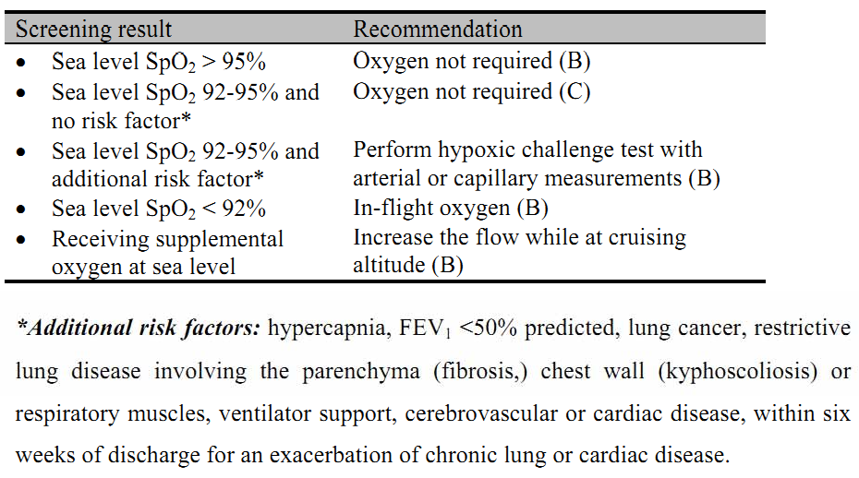
Pulse oximetry
BTS guidelines Thorax 2002;57;289‐304

Slide 29
6MWT
It has been standardized and validated
ATS: Am J Respir Crit Care Med 2002; 166: 111–117 Chetta A et al, Respiration 2009; 77: 361–367
It is widely used in lung function laboratories and the BTS recommends its use to evaluate the fitness to fly.
The desaturation observed during the hypoxia altitude simulation test (HAST) is strictly correlated and predicted by the 6MWT‐induced desaturation
Chetta A et al, Aviat Space Environ Med 2007; 78: 789–792.

Slide 30
Hypoxia Altitude Simulation Test
HAST is the ideal most frequently used test which exposes the subject to hypoxia in a hypobaric room.
The HAST is considered the gold standard in the assessment of fitness for flight.
Dillard TA et al, Aviat Space Environ Med 2007;78:143–144. Mohr LC et al, Chest 2008;133:839–842
In this test, subject is exposed to a hypoxic mixture of 15% oxygen and 85% nitrogen, from a Douglas bag or venturi mask, through a mouthpiece or a facial mask, connected to a two‐way valve.
Am Rev Respir Dis 1984; 130: 980–986.

Slide 31
SpO₂, PaO₂ and ECG monitored
The exposure lasts for 20 min or until the pulse oximeter data reaches a stable condition
This test is considered a reliable tool in predicting the hypoxemia measured during air travel both in healthy subjects and in COPD patients
Kelly PT et al, Aviat Space Environ Med 2006; 77: 1143–1147. Kelly PT et al, Chest 2008; 133: 920–926.

Slide 32
In case a significant hypoxemia occurs, the test must be repeated with oxygen supplementation through nasal cannula to titrate the necessary flow during the flight, starting with a flow of 2 l/min
Mohr LC et al, Am J Med Sci 2008; 335: 71–79. Dine CJ et al, Chest 2008; 133: 1002–1005.
In case of border line results it can be useful to perform a second test while the patient performs modest exercise, such as walking on a treadmill
Dine CJ et al, Chest 2008; 133: 1002–1005.

Slide 33
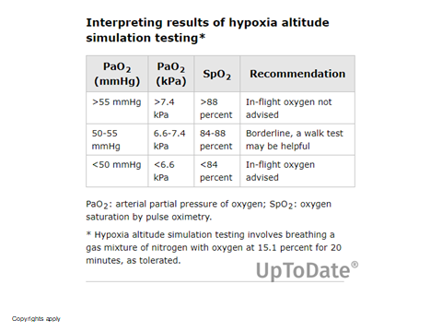

Slide 34
Oxygen supplementation
The need for oxygen should be disclosed when the patient books with the airline
The airline medical department will issue a MEDIF form or their own medical form which to be completed by both the patient and the Pulmonologist
The airline’s Medical Officer then evaluates the patient’s needs

Slide 35
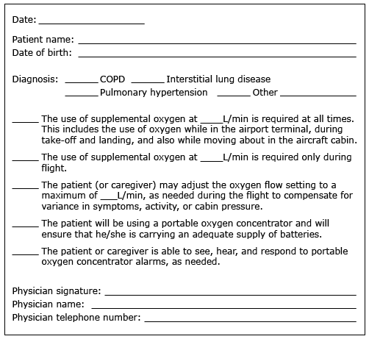

Slide 36
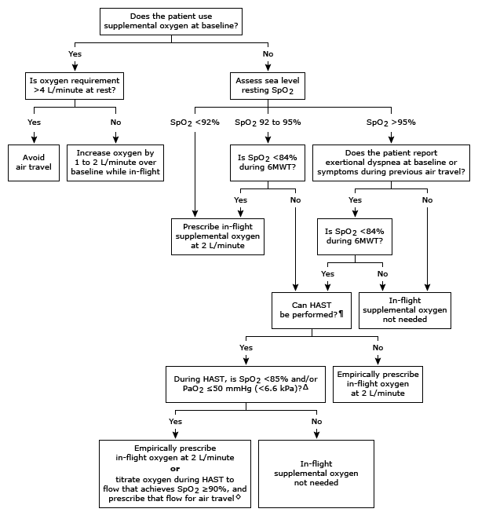

Slide 37
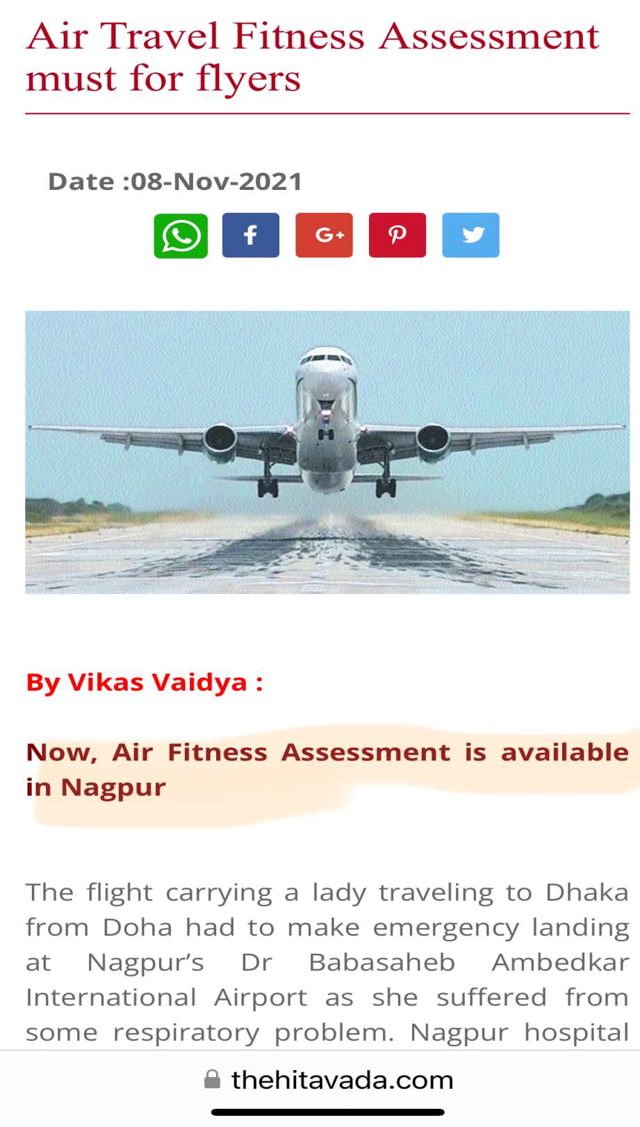

Slide 38
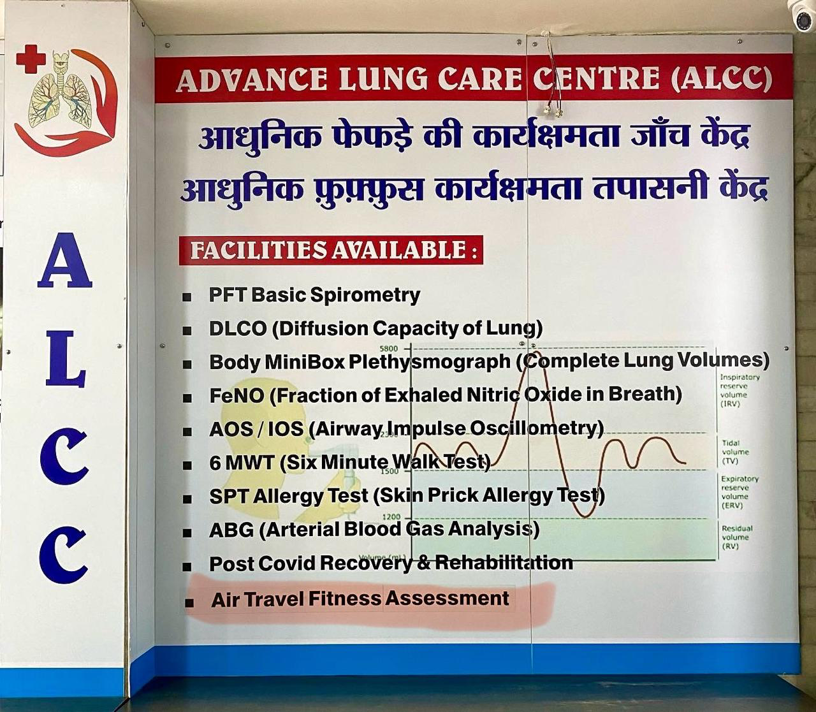

Slide 39
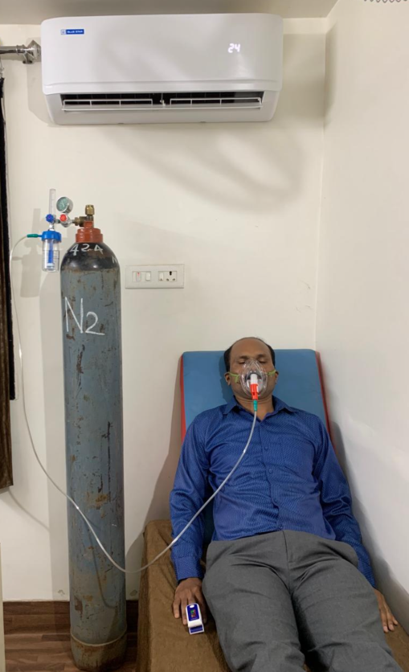
Thus by conducting air travel fitness assessments we can help ensure the safety of our
patients with respiratory diseases during their air travel and guide them to take optimal precautions for happy landing.

Slide 40
